Slide 1
Hyperbaric
Oxygen Therapy and Pain
Rita Katznelson , MD FRCPC
Toronto General Hospital

Slide 2
Defining The Problem
Pain is extremely common and yet poorly managed
Important source of disability
Cost of pain is hundreds billions of dollars annually
The pain management is a challenge
HBOT is a novel method to control pain (?)

Slide 3
Objectives
Definition of HBOT, indications/contraindication/side effects
Mechanisms of HBOT
HBOT and animals models of pain
HBOT and pain in humans

Slide 4
HBOT
Unique intervention
Poorly understood mechanism of action
Increased use in a number of areas of medical practice

Slide 5
Definition
Undersea and Hyperbaric Medical Society:
Hyperbaric oxygen (HBO₂) is a treatment, in which a patient breathes 100% oxygen intermittently while inside a treatment chamber at a pressure higher than sea level pressure ( > 1.4 ATA)

Slide 6
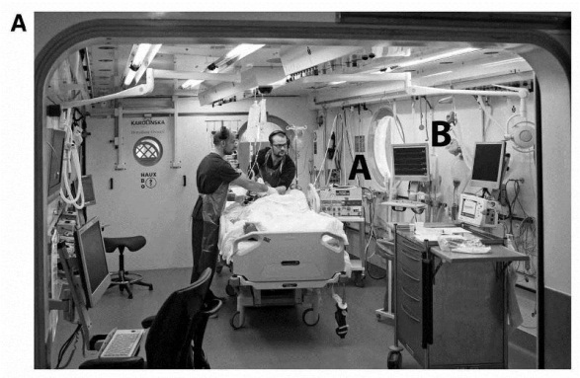
Multiplace chamber
Several patients at the same time/critically ill patients
Needs inside observer
Patients in a multiplace chamber breathe 100% oxygen via a mask ,close-fitting plastic hood, ETT
Pressure up to 6 ATA

Slide 7
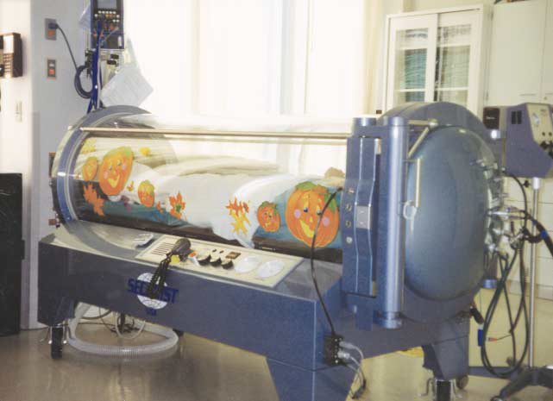
Monoplace chamber
Single patient, chronic conditions
Chamber is pressurized with 100% O2
Air masks used for air breaks
Medical personnel is outside
IV lines and ventilation ducts can penetrate through the hull.

Slide 8
History
1662- England, Henshaw : first hyperbaric chamber
1837- France, Pravaz : large hyperbaric chamber to treat tuberculosis, laryngitis, tracheitis and pertussis, deafness, cholera, rickets, menorrhagia , conjunctivitis
1877 -Fontaine :first mobile hyperbaric operating theatre

Slide 9
History
1860-Oshawa: The first hyperbaric chamber in North America
1928 -Cunningham: biggest hyperbaric chamber in the world.
1956- Boerema : hyperbaric oxygen in cardiopulmonary surgery
1959 - Brummelkamp: anaerobic infections were inhibited by hyperbaric therapy.
1962- Smith and Sharp: benefits of HBO in carbon monoxide poisoning.

Slide 10
Physics
HBOT increases the ambient PO2 and causes a dramatic increase in the amount of dissolved oxygen carried by the blood.

Slide 11
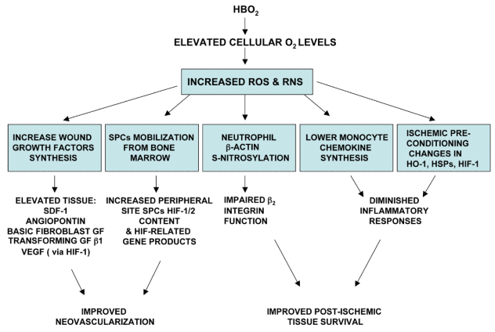
Physiology

Slide 12
Physiology
Angiogenesis
Fibroblast proliferation/collagen synthesis
Reduces intravascular leukocyte adherence
Leukocyte oxidative killing
Toxin inhibition
Antibiotic synergy
Vasoconstriction
Redistribution of cerebral blood flow
Stimulates brain neuroplasticity

Slide 13
Indications
Air or gas embolism
Decompression sickness
Carbon monoxide poisoning
Severe anemia
Clostridium myositis and myonecrosis, necrotizing soft tissue infections
Crush injury, Compartment Syndrome and other acute traumatic ischemias
Enhancement of healing for wounds such as diabetic foot ulcers;
Intracranial abscess
Refractory osteomyelitis
Delayed radiation injury
Compromised skin grafts and flaps
Thermal burns
Retinal artery occlusion
Acute idiopathic sensorineural hearing loss

Slide 14
Absolute Contraindications
Untreated Pneumothorax
Bleomycin
Cisplatin
Disulfirum
Doxorubicin

Slide 15
Relative Contraindications
Asthma
URTI
Severe COPD
Claustrophobia
High Fever
Seizures
CHF

Slide 16
Relative Contraindications
Asthma
URTI
Severe COPD
Claustrophobia
High Fever
Seizures
CHF

Slide 17
Complications
Barotrauma
CNS toxicity
Pulmonary toxicity
Myopia ( reversible)

Slide 18
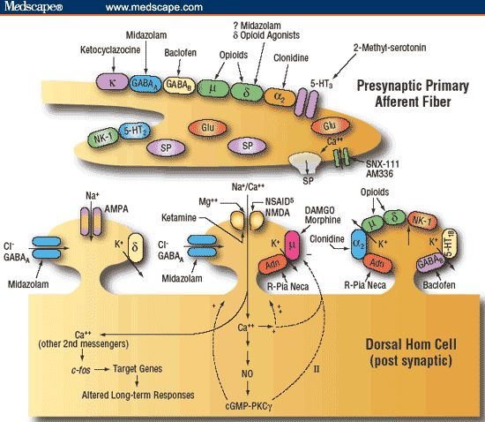
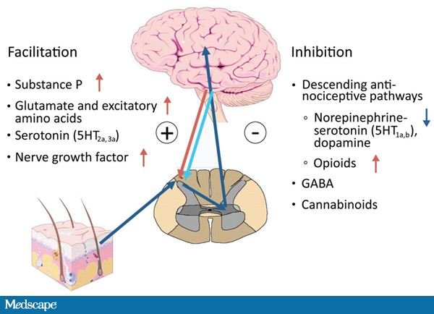
HBOT and Pain

Slide 19
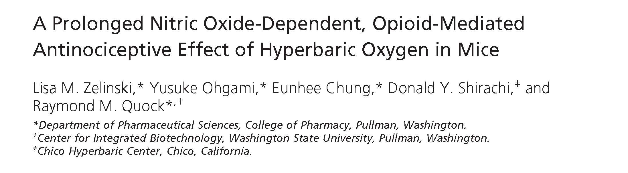
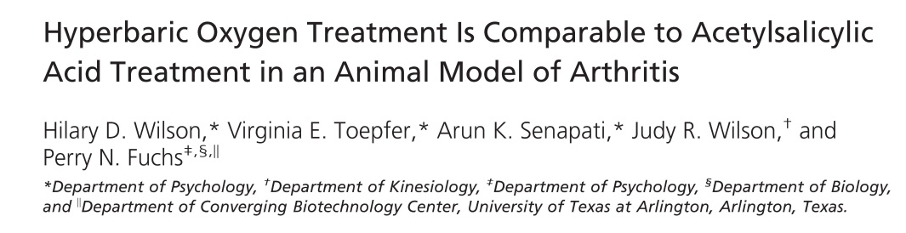

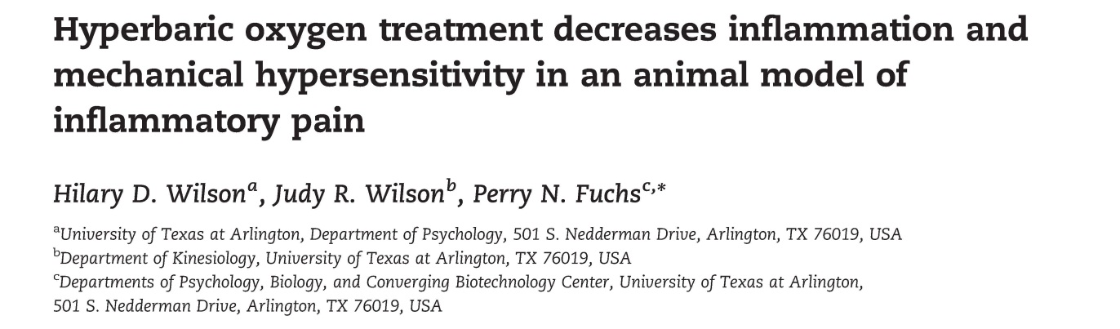
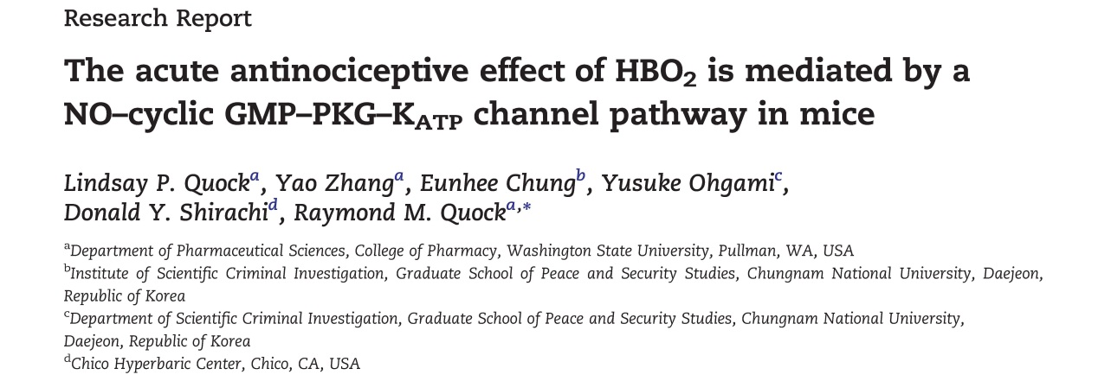
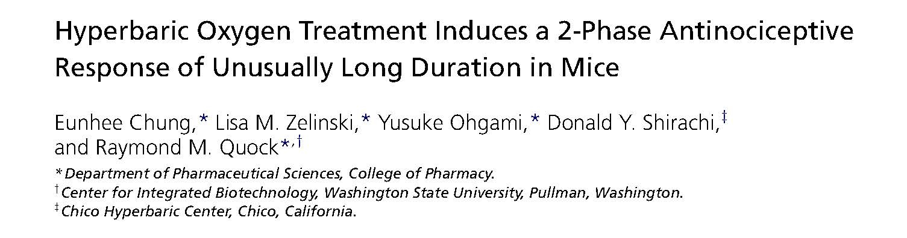
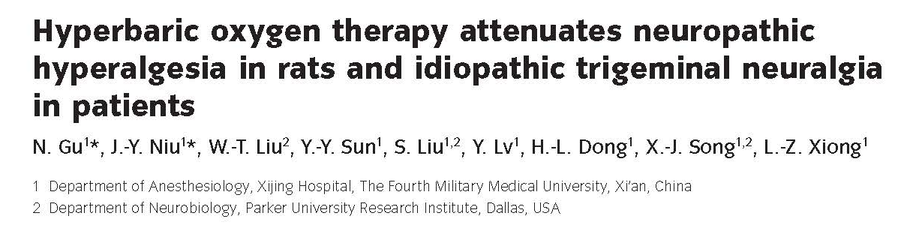
HBOT and Pain

Slide 20
HBOT and Inflammatory Pain
HBOT decreases mechanical hyperalgesia in an acute inflammatory pain condition
HBOT is as effective as aspirin to decrease inflammation and mechanical hypersensitivity
Wilson HD, et al. Brain Res 1098:126-128, 2006:
Wilson HD, et al. The Journal of Pain, 8: 12 2007: 924

Slide 21
Inflammatory Pain and HBOT
Wilson HD et al. Hyperbaric oxygen treatment decreases inflammation and mechanical hypersensitivity in an animal model of inflammatory pain.
Brain Res 1098:126-128, 2006:

Slide 22
HBOT and Nociceptive Pain
Neuronal Nitric Oxide is critical in acute antinociceptive effect of HBOT
HBOT regulates spinal NOS expression
HBOT-induced acute antinociception is
due to activation of a NO–cyclic GMP–protein kinase G–KATP channel pathway
Zelinski L, et al. J Pain 2009; 10:167–72.
Ohgami ,Y et al. NeuroReport 2009; 20:1325–9
Quock L, et al. Brain Research 2011;1368:102-7
Han G, et al. Pain Res Manag, 2013; 18:137-41

Slide 23
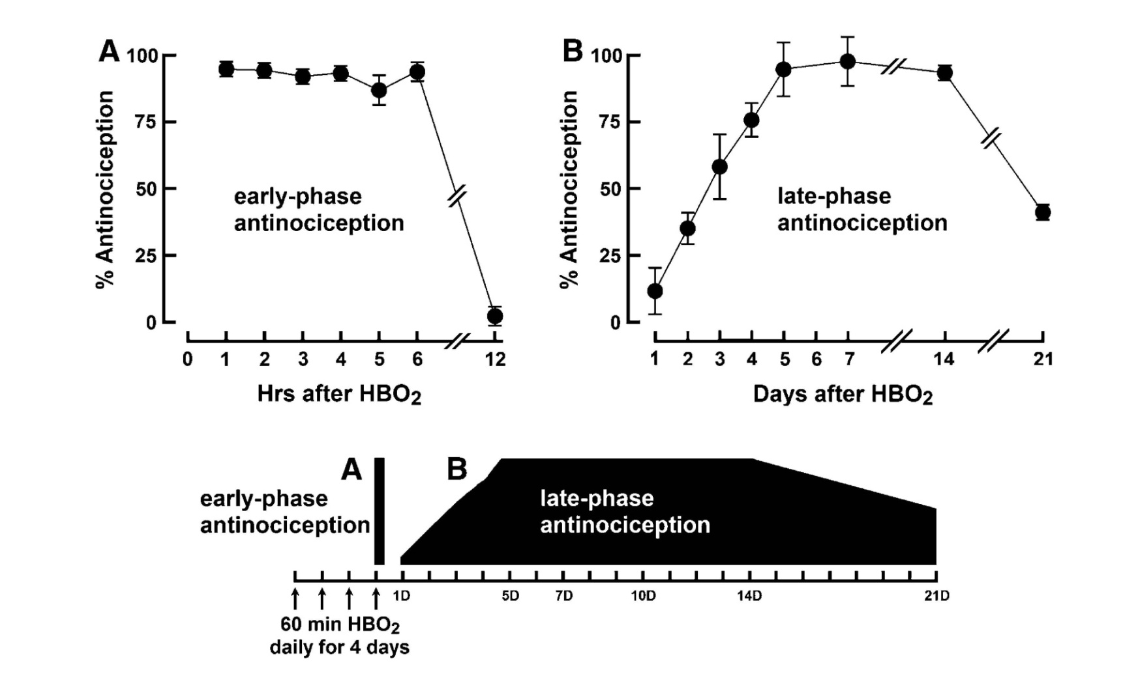
HBOT and Nociceptive Pain
Chung E, et al. The Journal of Pain, 2010; 11: 847-53

Slide 24
HBOT and Nociceptive Pain
Brain and spinal cord NO and opioid receptors play a key role
Acute antinociceptive effect of HBO2 involves neuronal release of dynorphin and activation of κ- and μ-opioid receptors in the spinal cord.
Chung E, et al. The Journal of Pain, 2010; 11: 847-53
Heeman JH, et al. Brain Res 2013 Oct 7

Slide 25
HBOT and Neuropathic Pain
Effective in different neuropathic pain models
Decreases cold, thermal and mechanical allodynia
The effect lasts for 5 days post-treatment
Thompson C, et al. Neuroscience Research 2010;66: 279–283
Fenghua L, et al. Anesth Analg 2011;113:626–33
Gu N, et al. Eur J Pain 2012;16: 1094–1105

Slide 26
HBOT and Neuropathic Pain
Reduces endoneural production of TNF- α
Reverses NMDA receptors alterations
Inhibits activation of astrocytes
Regulates spinal NOS expression
Thompson C, et al. Neuroscience Research 2010;66: 279–283
Fenghua L, et al. Anesth Analg 2011;113:626–33
Gu N, et al. Eur J Pain 2012;16: 1094–1105
Han G, et al. Pain Res Manag 2013;18(3):137-41

Slide 27

HBOT and Pain
Nociceptive
pain
Inflammatory
pain
Neuropathic
pain

Slide 28
HBOT and Human studies
Cancer pain
Headaches
Interstitial cystitis
Trigeminal neuralgia
CRPS
Fibromyalgia

Slide 29
HBOT and Headache
HBOT :
Affects serotonergic system
Suppresses Substance P
Di Sabato F, et al.: Effect of hyperbaric oxygen on the immunoreactivity to substance P in the nasal mucosa of cluster headache patients. Headache 1996, 36:221–223.
Di Sabato F,etal,: Hyperbaric oxygen in chronic cluster headaches: influence on serotonergic pathways.
Undersea Hyperb Med 1997,24 :117–122.

Slide 30
HBOT and Headache
HBOT induced analgesia in patients with cluster headaches was correlated with serotonin binding to mononuclear cells and the concentration of substance P in nasal mucosa of treated individuals
Di Sabato F, et al.: Effect of hyperbaric oxygen on the immunoreactivity to substance P in the nasal mucosa of cluster headache patients.Headache 1996, 36:221–223.
Di Sabato F,etal,: Hyperbaric oxygen in chronic cluster headaches: influence on serotonergic pathways. Undersea Hyperb Med 1997,24 :117–122.

Slide 31
HBOT and Headache
9 trials, 201 participants
5 trials: HBOT vs sham therapy for acute migraine
2 trials: HBOT vs sham therapy for cluster headaches
HBOT relieves migraine headaches
Trend to terminate cluster headache
Bennett MH et al. Cochrane Database Syst Rev. 2008 Jul 16;(3)

Slide 32
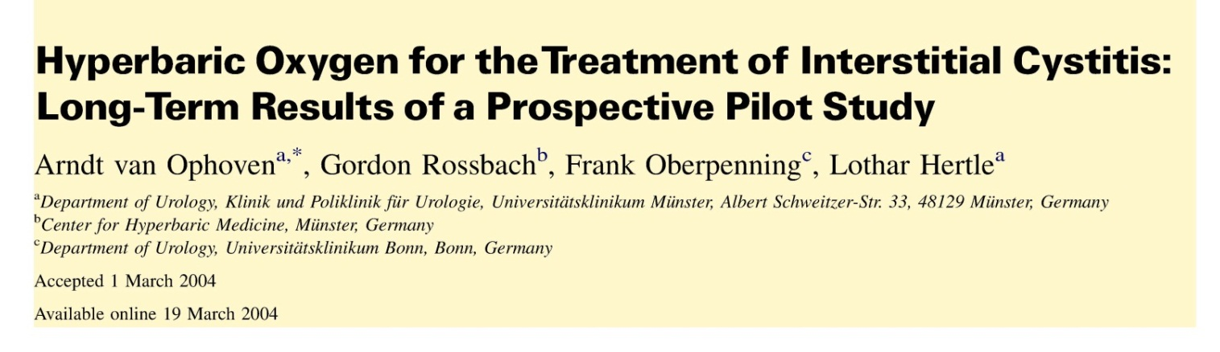

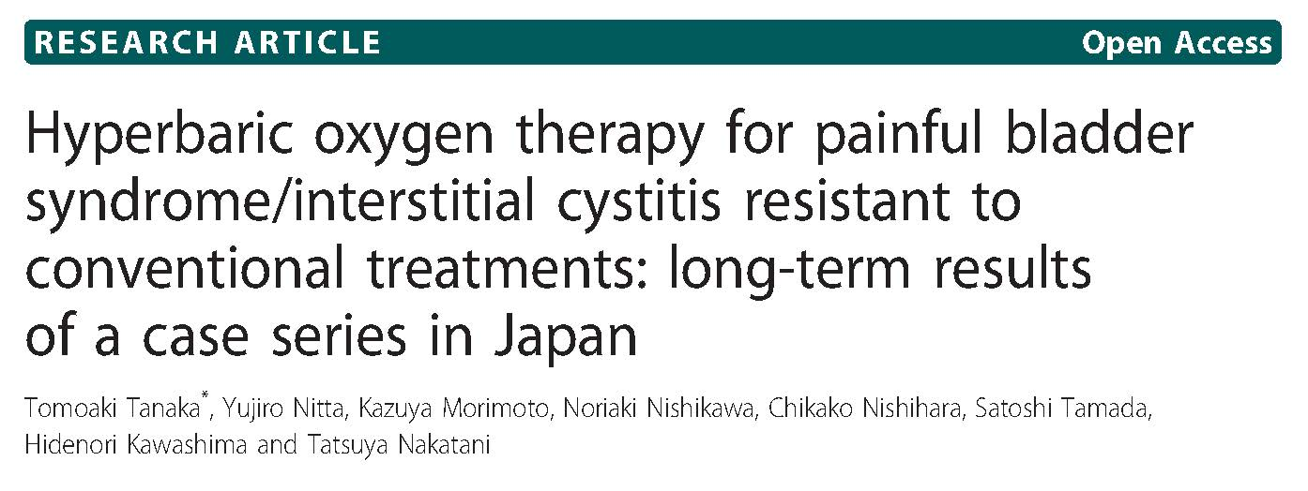
HBOT and Interstitial Cystitis

Slide 33
HBOT and Fibromyalgia
Mechanisms of therapeutic effect :
Muscle oxygenation
Restoration of aerobic metabolism
Correction of hypoxia, tissue acidosis
Modulating NO activity and oxidative stress
Alteration of serotonergic system
Modulation of inflammatory response

Slide 34
HBOT and Fibromyalgia
Randomized double blind controlled study
50 FM patients, 90 min, 2.4 ATA, x 15
Reduction in pain scores, number of trigger points, an increase in pain threshold
Yildiz S, et al. A new treatment modality for fibromyalgia syndrome:
Hyperbaric oxygen therapy. J Int Med Res 2004 May-Jun; 32(3): 263-7

Slide 35
HBOT and CRPS
Double-blind, randomized, placebo-controlled study
71 pts, HBOT vs sham, 15 sessions
HBOT group: decrease in pain and edema; increase in the ROM of the wrist.
Kiralp MZ,et al.: Effectiveness of hyperbaric oxygen therapy in the
treatment of complexregional pain syndrome.
J Int Med Res 2004, 32:258–262

Slide 36
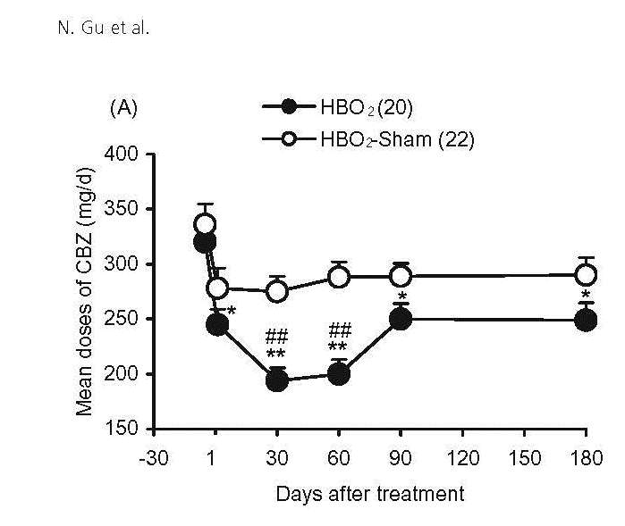
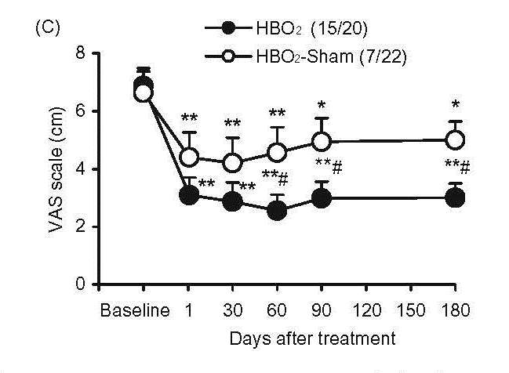
HBOT and Trigeminal Neuralgia
RCT, 42 patients treated with carbamazepine
HBO 1.8 ATA, 70 min x 10
Gu N., et al,Eur J Pain 2012;16: 1094–1105

Slide 37

HBOT and Pain
Dinorphin
NO
Opioid receptors
NMDA
receptors
Tissue O2
Tissue pH
Inflammation
Serotonin
Substance P
TNFα

Slide 38
Thank you!
rita.katznelson@uhn.ca

