Slide 1
The Intersection of Two Public Health Problems: Under Treatment of Pain and Abuse and Misuse of Pain Medications
Richard C. Dart, MD, PhD
Director, Rocky Mountain Poison and Drug Center
Professor, University of Colorado

Slide 2
Outline
Worldwide Challenges
RADARS System
Data from US and Canada
Framework for understanding and intervention
Discussion

Slide 3
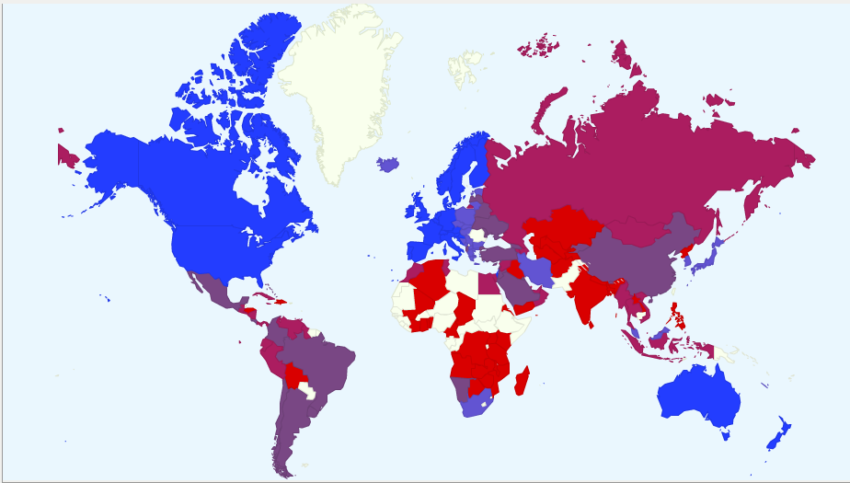
Opioid Consumption (ME/capita), 2010

Slide 4
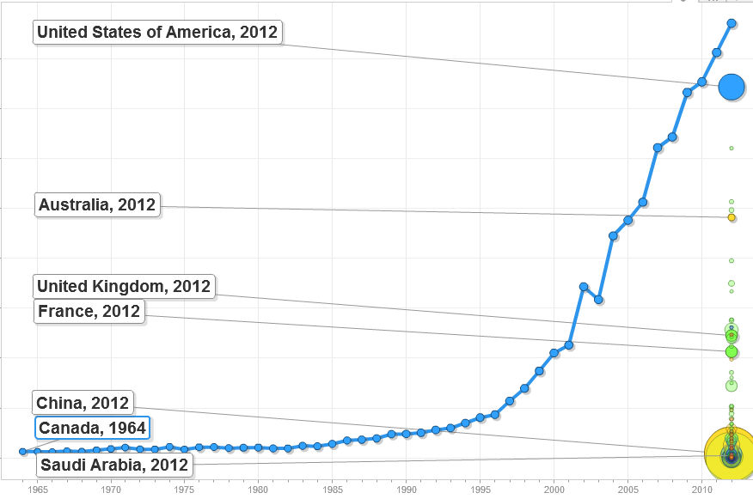
Consumption of Prescription Opioids, 1964 - 2012
> 800 morphine equivalents/capita!
http://www.painpolicy.wisc.edu/global

Slide 5
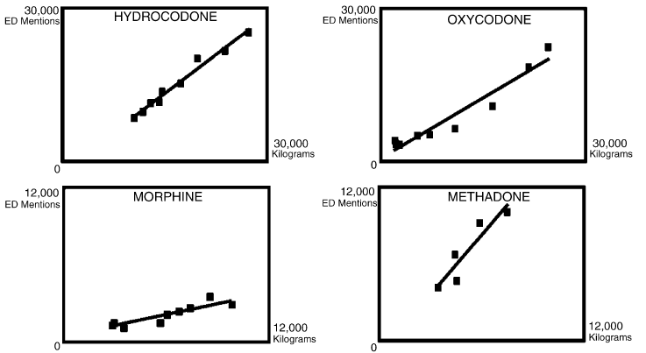
More Drug Production = More Drug Abuse But - the Slope Varies by Drug
Dasgupta N et al. Drug Alcohol Depend. 2006;82(2):135-142.

Slide 6
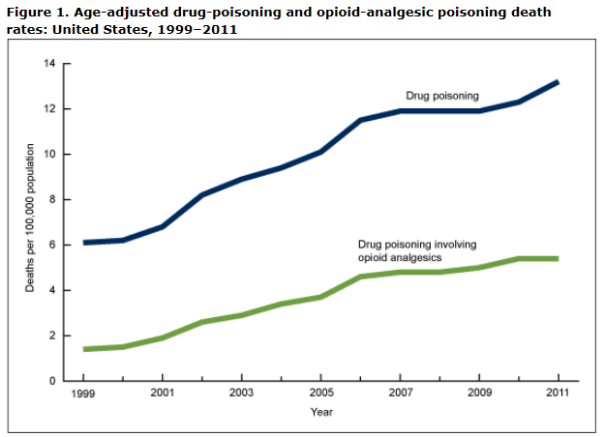
Drug-Poisoning and Opioid Analgesic Poisoning Death: United States, 1999-2011
30,000 deaths
http://www.cdc.gov/nchs/data/databriefs/db166.htm

Slide 7
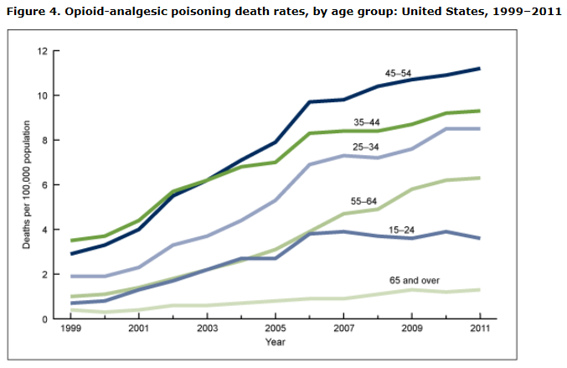
Opioid Analgesic Poisoning Death, by Age Group, United States, 1999-2011
http://www.cdc.gov/nchs/data/databriefs/db166.htm

Slide 8
What is the RADARS® System?
History
2002, Purdue Pharma
2006, Denver Health and Hospital Authority
Rocky Mountain Poison and Drug Center
Denver Public Hospital for 150 years
State sanctioned independent authority.
DHHA
RMPDC
RADARS
System
Conflict of Interest Statement
Most manufacturers of prescription opioids or stimulants subscribe to RADARS System.
RADARS System is the property of Denver Health and Hospital Authority, a political subdivision of the State of Colorado.
Subscribers receive information, but do not participate in developing the System, data collection, or analysis of the data. They do not have access to the raw data.
Employees are prohibited from personal financial relationships with any company.
Notes:
IN:
EXPLAIN:
OBS:
OUT:

Slide 9
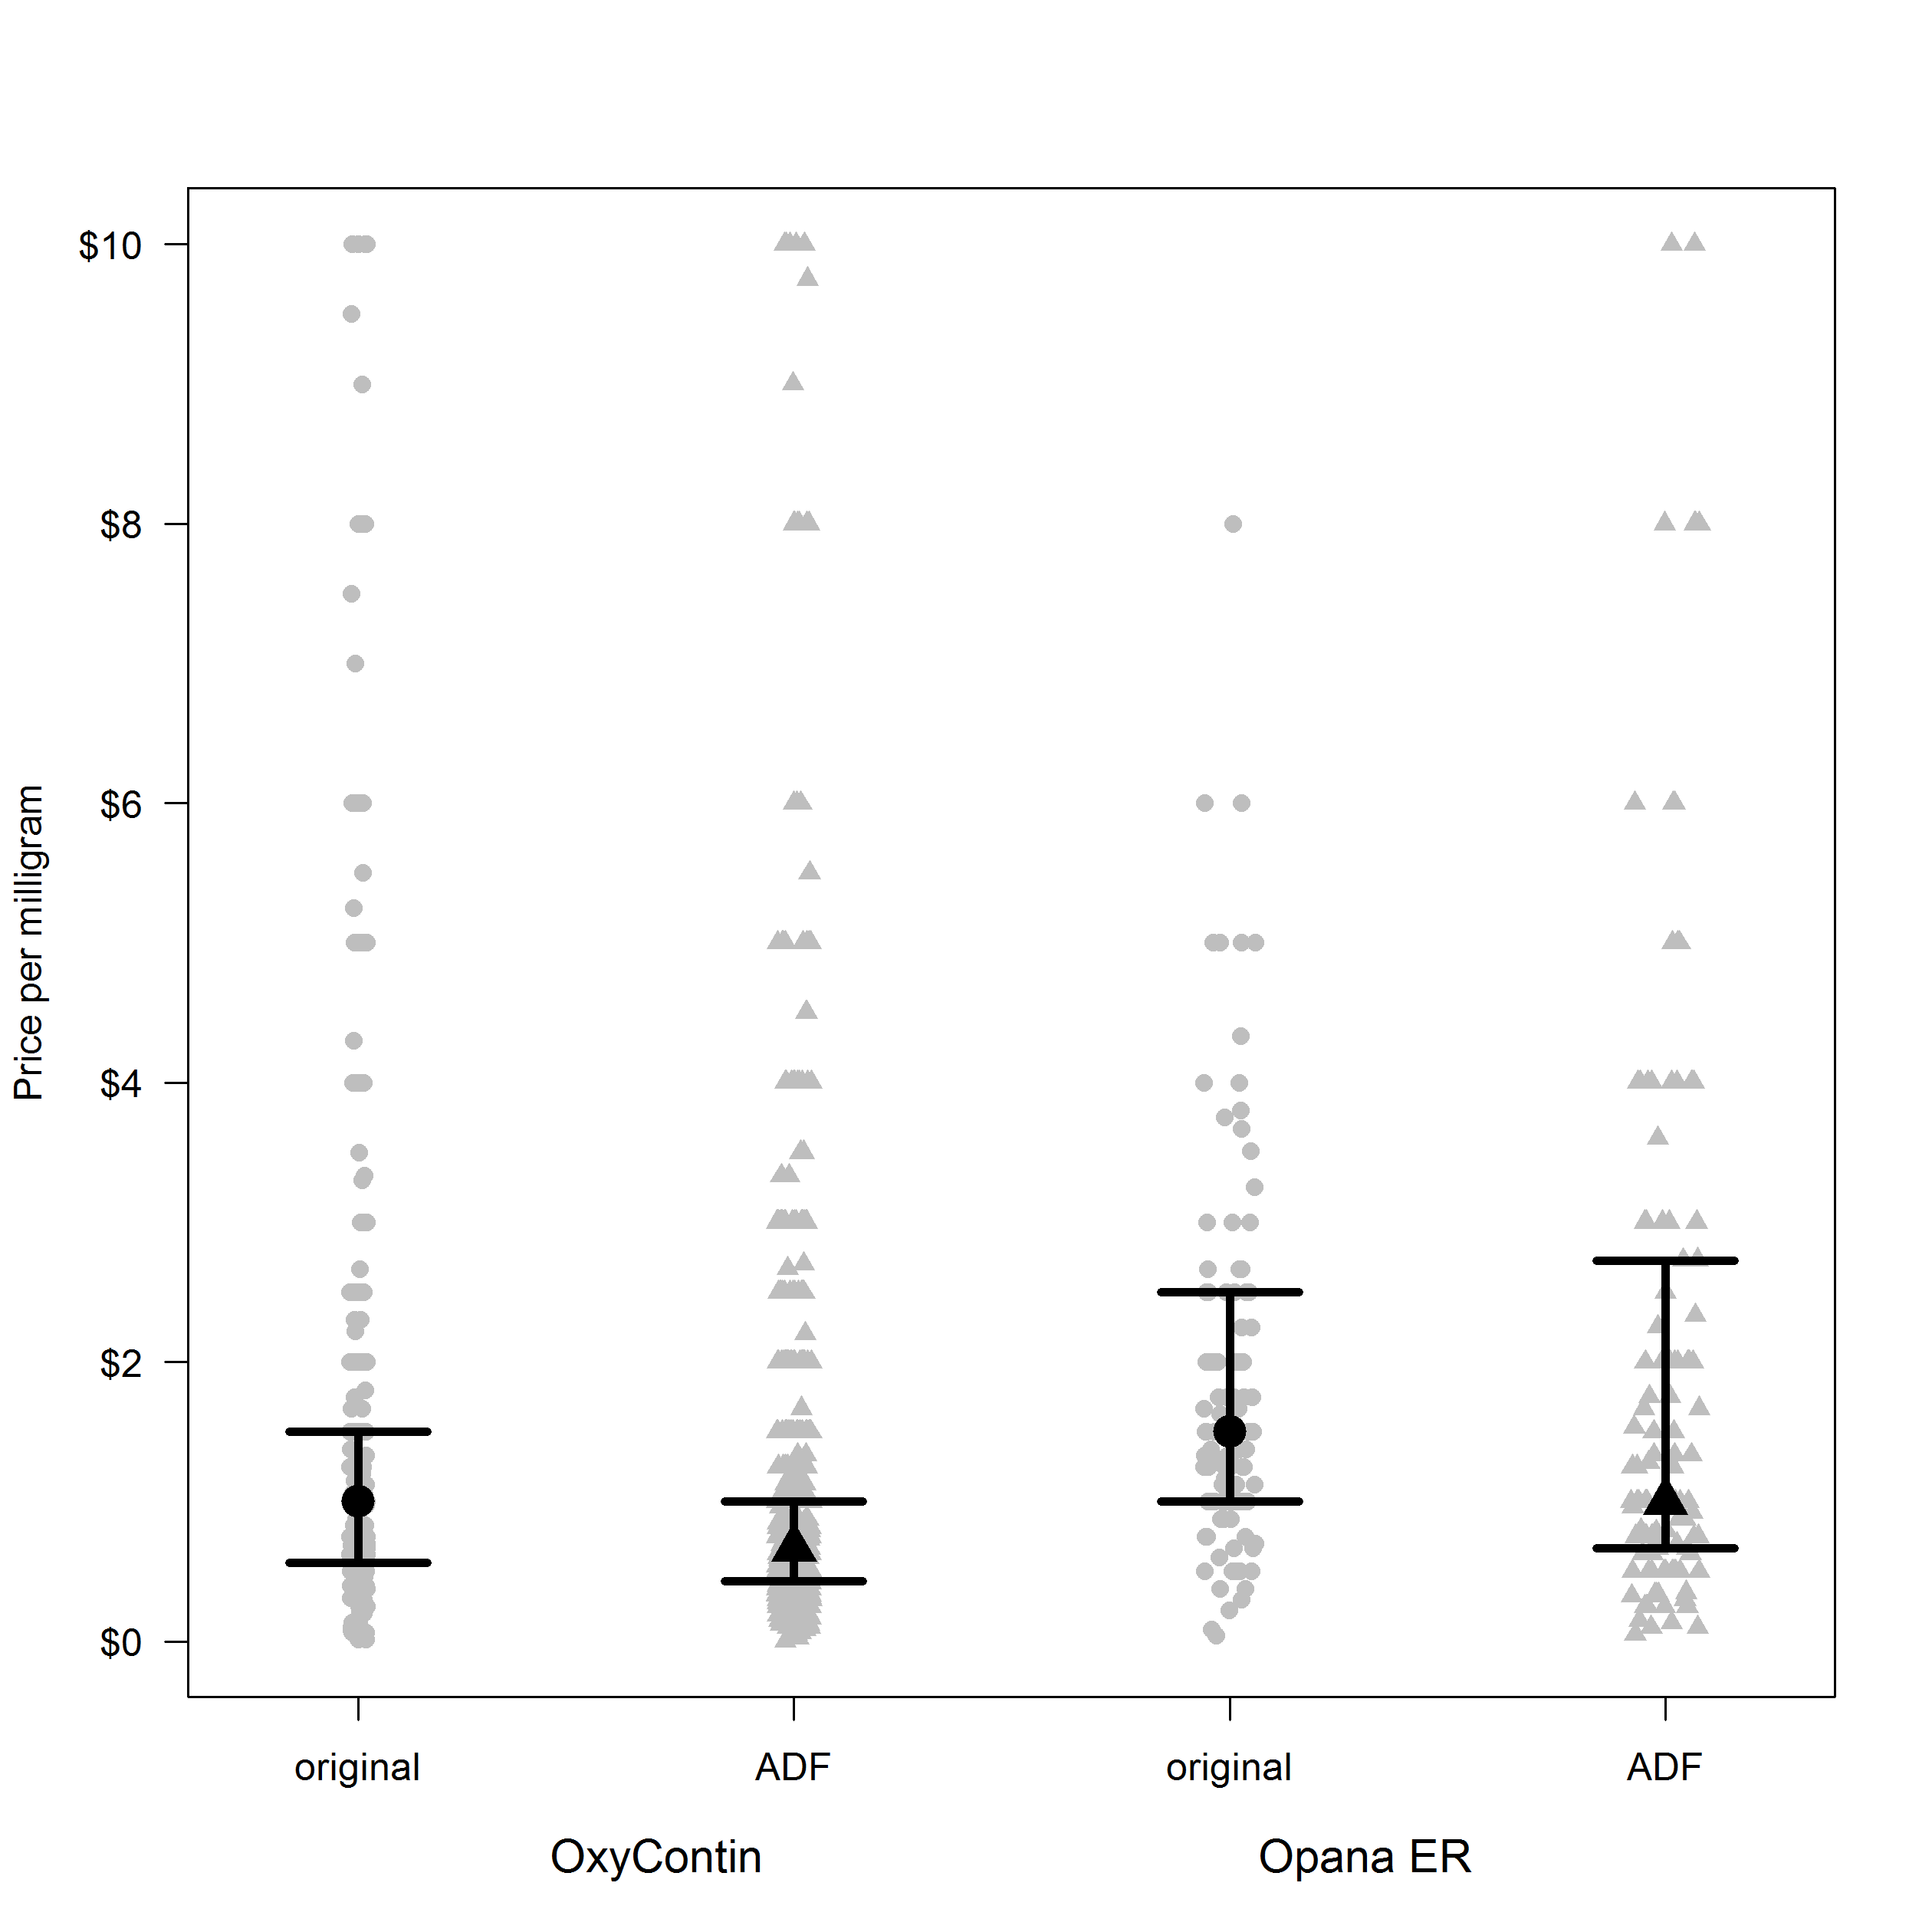
Mosaic Surveillance of Prescription Drug Abuse - 2013
49 Poison centers
46 states
456,610 cases
491,874 opioid
mentions
Criminal Justice
260 agency; 49 states
145,090 cases with 146,786 opioid
mentions
Acute Health Events
Drug Transactions
Opioid Tx Program
66 programs; 34 states
41,031 cases with 183,573 opioid
mentions
SKIP
109 practices, 45 states
10,214 cases with
64,678 opioid
mentions
Entering Treatment
Entering Treatment
StreetRx
College Survey
2000 students, 50 state
3,564 cases with
11,871 opioid mentions
StreetRx.com
Users/Buyers, 50 states
8,441 price entries for
an opioid
New Initiates
Illicit Market Price
Web
Monitoring
> 150 million sites
monitored
> 35,000 posts
coded for analysis
Notes:
IN:
EXPLAIN:
OBS:
OUT:

Slide 10
Abuse Deterrent Formulations
Notes:
Our point here is not to endorse ADFs, but to show how the data explain and reveal differences between two presumably similar products – Reformulated OxyContin and Opana ER.
IN:
EXPLAIN:
OBS:
OUT:

Slide 11
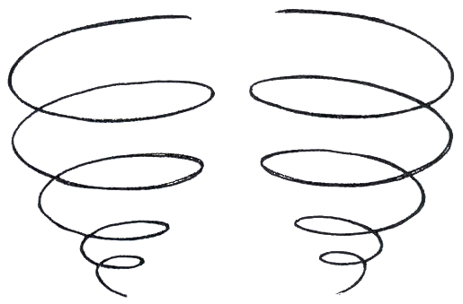
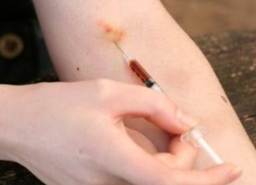
Abuse Deterrent Formulations
Population of People with Addiction Risk
Exposed to Opioid
Can ADFs Minimize Progression?
Swallow
Misuse/Abuse
Chew
Crush
Currently
Approved
ADFs
Snort
Inject
Notes:
There are potentially 2 mechanisms by which ADFs could reduce abuse and diversion.
OUT: Let’s see how the data address these mechanisms.

Slide 12
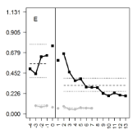
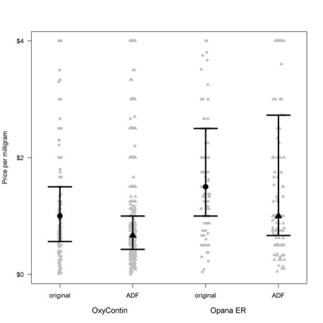
Mosaic Surveillance on Opana ER and OxyContin
Poison Center Program
Drug Diversion Program
Population
Population
Treatment Programs COMBINED
StreetRx
Population
Price per milligram
Notes:
IN: This slide shows the populations rates from RADARS system for reformulated OxyContin and Opana ER.
Explain slide:
“Mosaic” starting with PC Program.
Treatment programs are combined.
Reformulated OxyContin is the dark line and Opana is the light gray line.
The vertical line is the time the reformulated version of each drug was introduced.
Observations:
The patterns both show decreased in terms of population after introduction of a reformulated version.
Opana is lower in with each denominator
OUT: Let’s see what happens when we take availability into account.

Slide 13
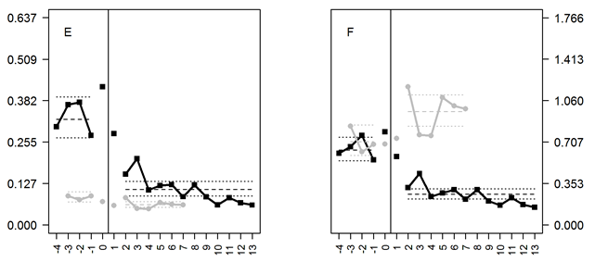
Mosaic Surveillance on Opana ER and OxyContin
Poison Center Program
Drug Diversion Program
Population
URDD
Population
URDD
Treatment Programs COMBINED
StreetRx
Population
URDD
Population
URDD
URDD – Unique Recipients of Dispensed Drug
Notes:
IN: This slides shows the same data and adds the denominator of URDD – Unique Recipients of Dispensed Drug
EXPLAIN: Vertical line still shows introduction of the reformulated version of each drug.
OBS:
Using the URDD denominator, OxyContin has the same pattern as the population denominator, however the effect is attenuated slightly. This may be because the demand for OxyContin decreased.
Opana is endorsed at higher rates than OxyContin using the URDD denominator in each program
And brings more per dollar spent on the street.
But there is another surprising observation – The divergence in patterns for Opana. Opana goes down in PC and DD, but does not decrease in treatment programs.
If you just based decision on population denominator – Opana gets exclusivity
OUT:

Slide 14
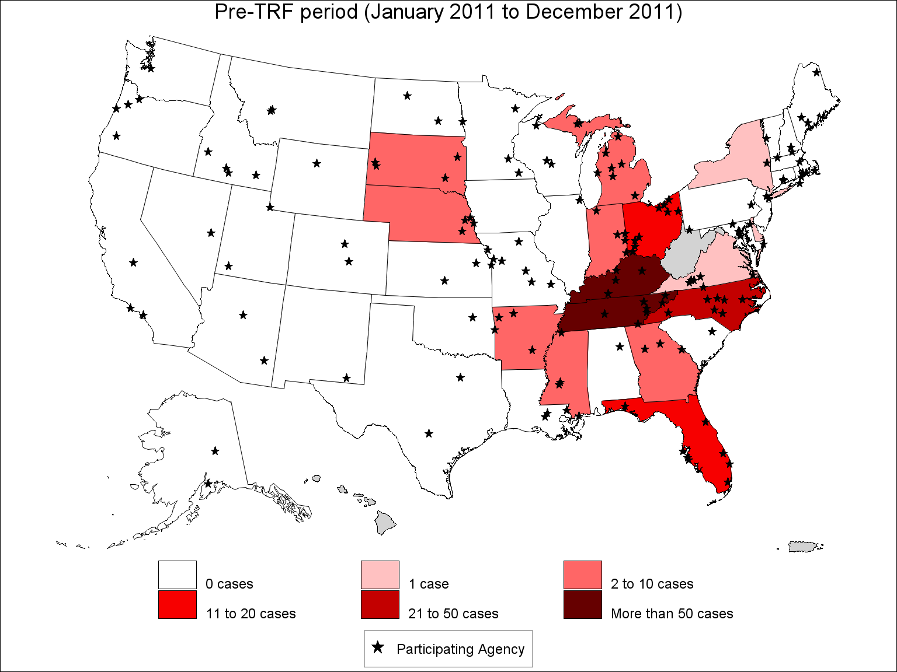
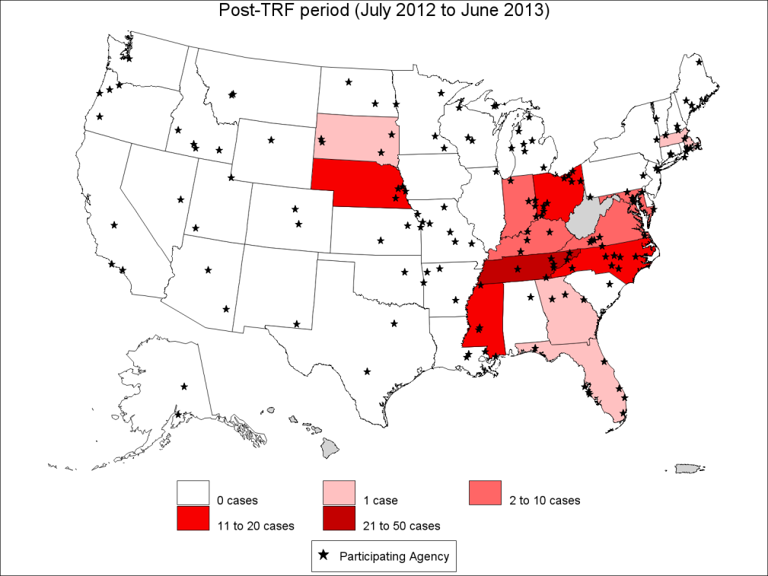
Drug Diversion Program ER Oxymorphone Diversion Cases January 2011 through June 2013
Before Reformulation
After Reformulation
Notes:
IN:
EXPLAIN:
OBS:
OUT:

Slide 15
Unanswered Questions

Slide 16
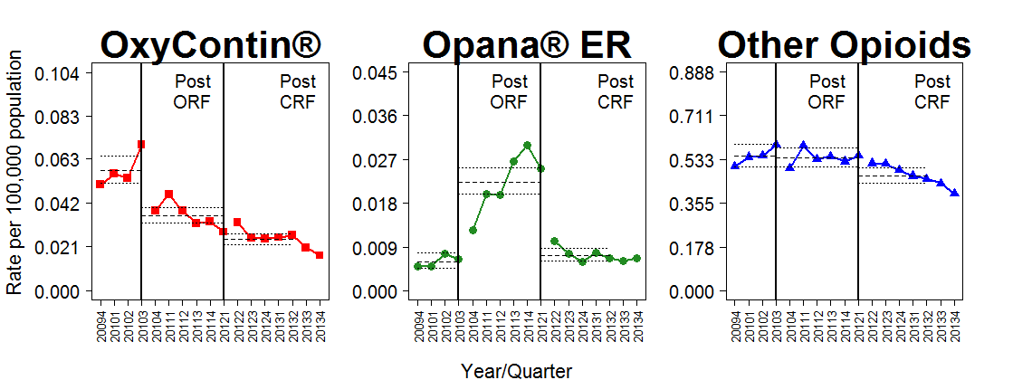
Drug Diversion Program ER oxymorphone diversion cases by state and time period January 2011 through June 2013
Notes:
IN:
EXPLAIN:
OBS:
OUT:

Slide 17
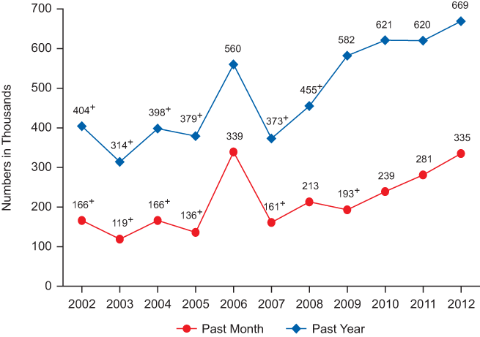
Squeezing the Balloon National Survey of Drug Use and Health, 2012
Reformulated OxyContin

Slide 18
Oxycodone ADF in US and Canada
Formulation | United States |  | Canada
 | Number reports | Median Price/mg, US Dollar (range) | Number reports | Median Price/ mg, Canadian Dollar (range)
Crushable “Old OxyContin”
Apo-Oxycodone CR (imprint APO OCD) | 87 | 1.00 (0.15 – 16.80) | 4 | 2.50 (1.00 – 6.00)
OxyContin® | 137 | 1.00 (0.01 – 12.00) | 43 | 1.00 (0.03 – 16.00)
Co-Oxycodone CR (imprint OXY CR) | 51 | 1.00 (0.05 – 22.00) | 3 | 1.00 (1.00 – 2.00)
Teva-Oxycodone CR (imprint N) | 8 | 0.38 (0.10 – 3.75) | 0 | NR
Median | 283 | 1.00 | 50 | 1.00
Abuse Deterrent “New OxyContin”
Oxycodone ER (OxyContin in US, OxyNEO in Canada) | 364 | 0.70 (0.03 – 10.00) | 23 | 0.63 (0.20 – 4.00)
Median | 364 | 0.70 | 23 | 0.63

Slide 19
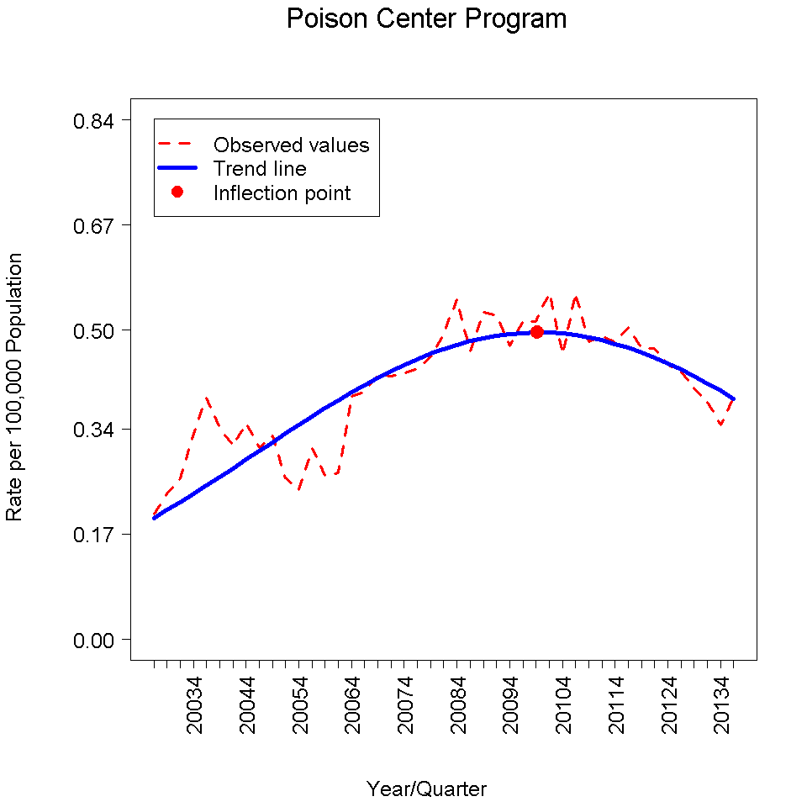
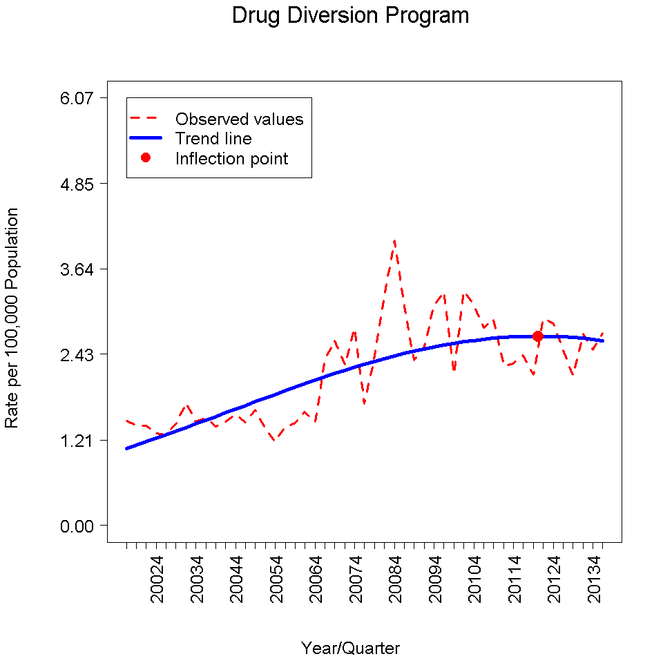
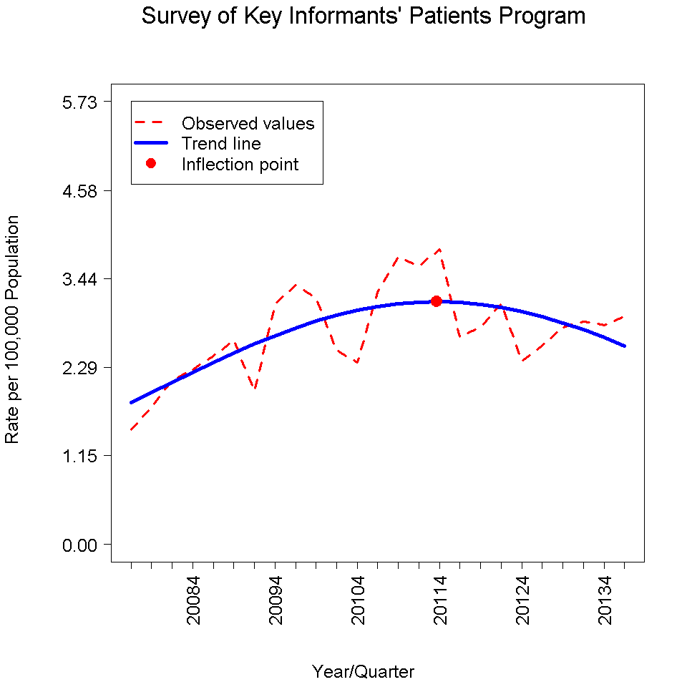
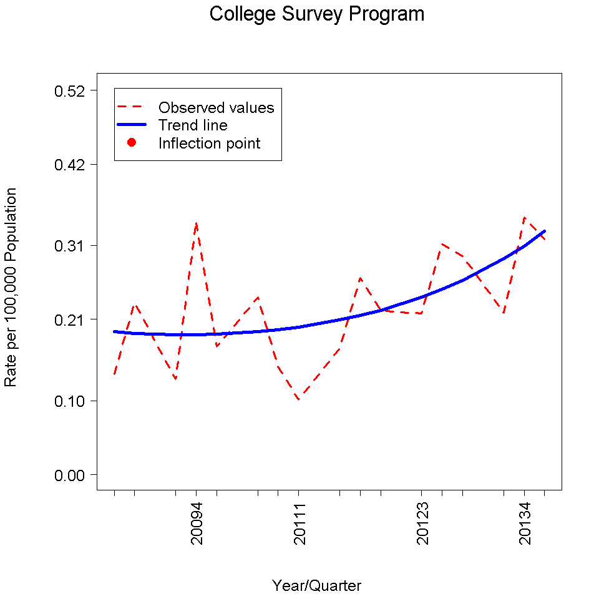
Opioid Analgesic Trends in the United States, 2014 Q1
Poison Center Program
Drug Diversion Program
Total
Total
Opioid Treatment Program
Survey of Key Informant Patients
Total
Total
College Survey Program
Total
Analgesic group:
oxycodone, hydrocodone,
hydromorphone, fentanyl,
morphine, and tramadol
Notes:
Slide shows trends in 6 opioid analgesics (oxycodone, hydrocodone, hydromorphone, fentanyl, morphine, and tramadol)
IN:
EXPLAIN:
OBS:
OUT:

Slide 20
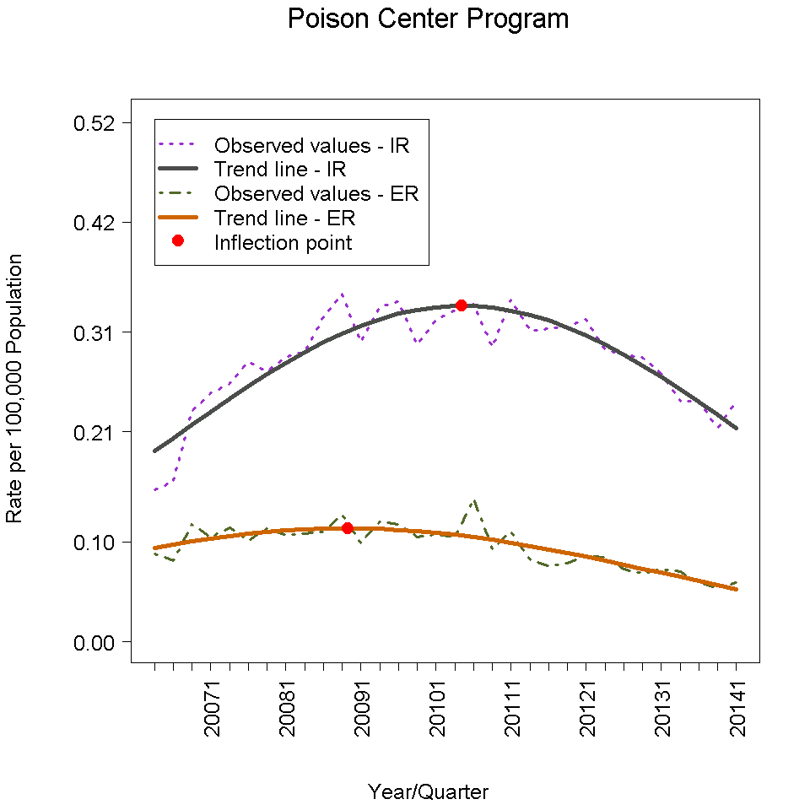
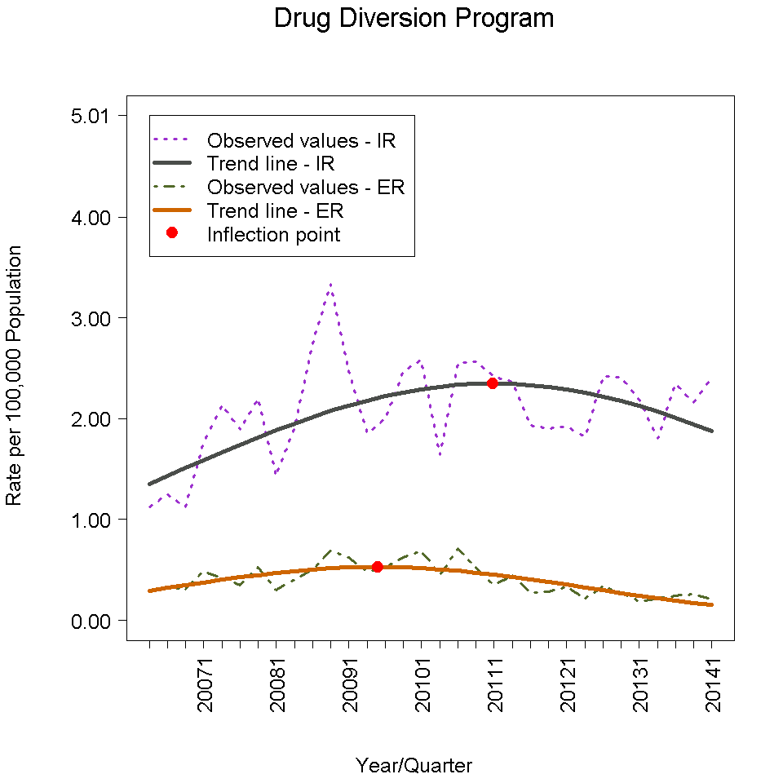
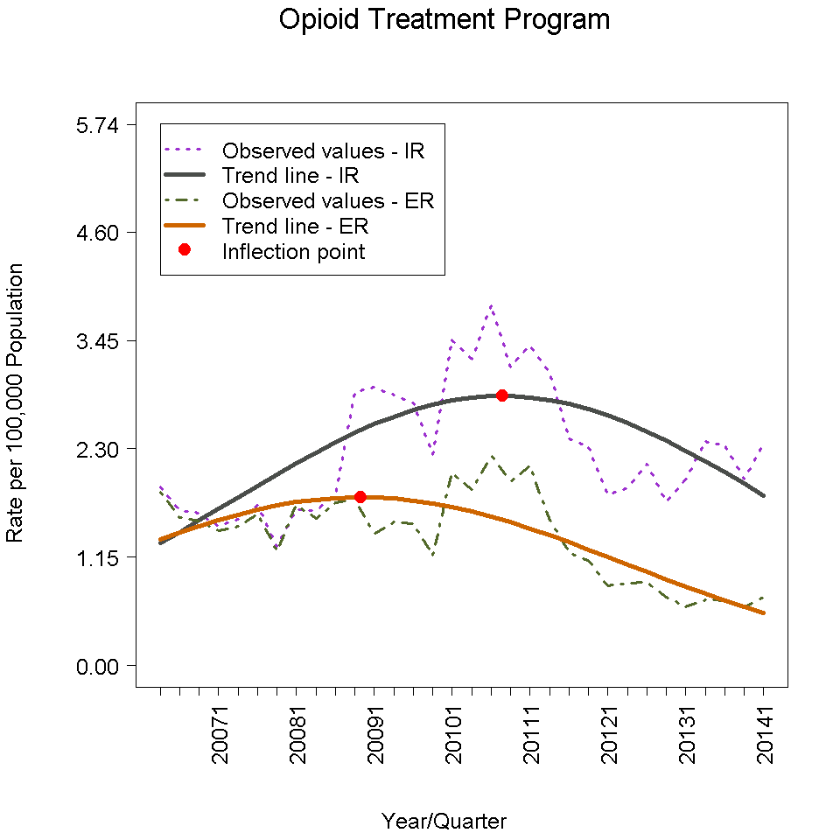
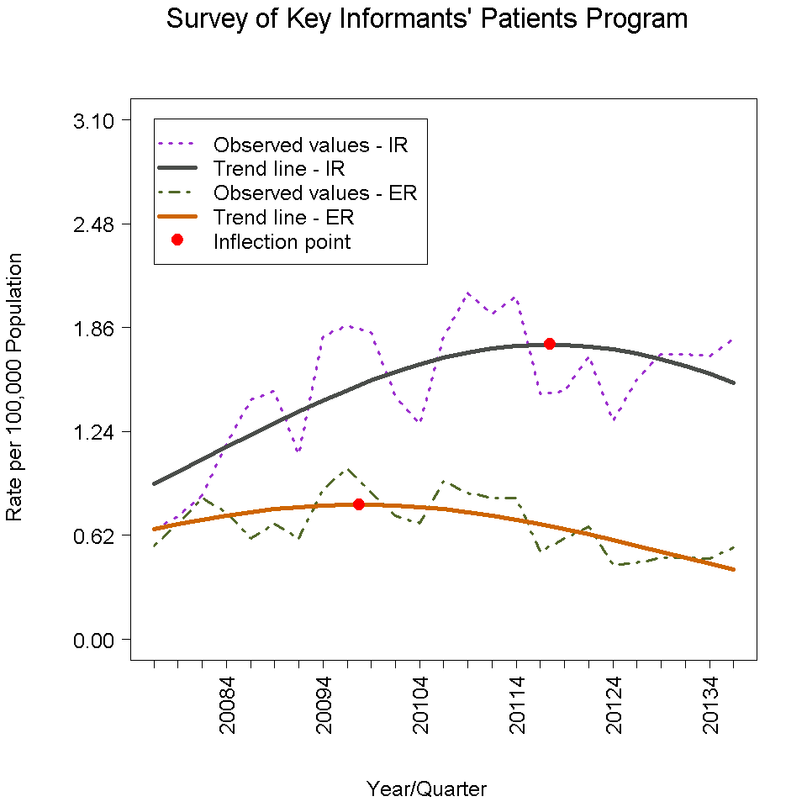
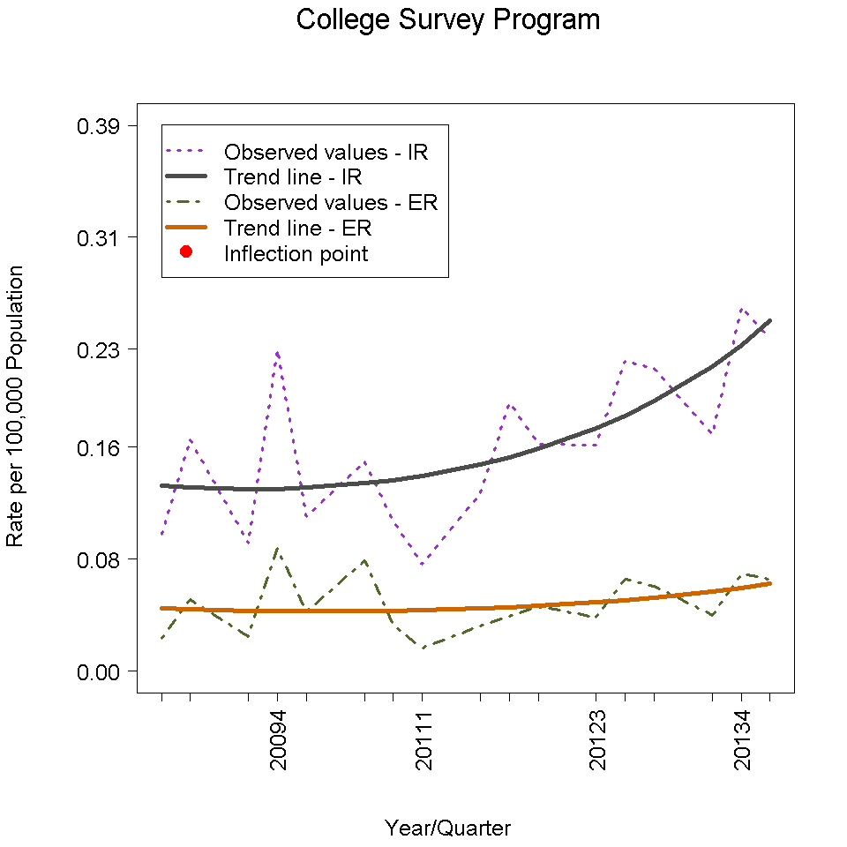
Opioid Analgesic Trends in the United States, 2014 Q1
Poison Center Program
Drug Diversion Program
Total
IR + ER
Total
IR + ER
Opioid Treatment Program
Survey of Key Informant Patients
Total
IR + ER
Total
IR + ER
College Survey Program
Total
IR + ER
Analgesic group:
oxycodone, hydrocodone,
hydromorphone, fentanyl,
morphine, and tramadol
Notes:
IN:
EXPLAIN:
OBS:
OUT:

Slide 21
What Changed?
Prescription Monitoring Plans (49 states)
Law Enforcement Efforts (Federal, State, Local)
Drug Diversion Investigators
Drug Takeback Days
Abuse Deterrent Formulations
Professional Education and Training/Guidelines
Public Education
FDA Risk Evaluation and Mitigation Strategy (REMS)
Rescheduling of Vicodin
Improved access to substance abuse treatment

Slide 22
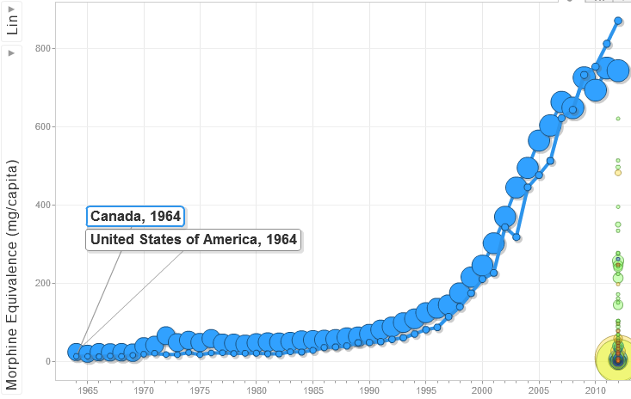
Conceptual Framework for Understanding Prescription Analgesic Abuse and Potential Interventions
ADF
FL
OC “Crushable”
Opioids Chronic Noncancer Pain
Papers, AAPM , APS, AGS, BPS, AAFP, >21 org
VA 5th VS
0
0
0
0
0
0
0
0
0
H
H
HC-APAP
Tramadol
0
H
0
H
H
WA/NY/ACEP
Rx Guidelines
H
H
H
H
TIRF REMS
ER/LA REMS
Natl Drug Take Back
1970
1980
1990
2000
2010
CA
PA
RI
NY
TX
MI
OK
HI
IN
MA
UT
IDc
IL
ME
MS
AL
CO
IA
AZ
KS
AL
FL
SD
WI
FKYL
OR
WV
WY
NM
OH
NC
LA
CT
MN
NV
Prescription Monitoring Plans
VA
TN
ND
SC
VT

Slide 23
DORA Issues 600 Notifications on Potential Doctor-Shopping
October 31, 2014
DENVER - Over 600 prescribers and pharmacies in the State are receiving a notification today from the Colorado Prescription Drug Monitoring Program (PDMP) that a patient they treat obtained potentially dangerous amounts of controlled substances from multiple prescribers and pharmacies.
In one instance, a patient obtained prescriptions from 11 different prescribers and 10 different pharmacies within 30 days…. Another person obtained over 1,600 pills of oxycodone and hydrocodone from multiple prescribers and dispensers in one month.

Slide 24
A Framework for Understanding Rx Drug Abuse
Population with Addiction Risk
↓
Exposed to Opioid
Intervention | Effect on Pain Tx
Prescriber Guidelines/ Training | +/-
Prescription Monitoring Plans | +/-
Abuse Deterrent Formulations | +
Law Enforcement | -
Public Education | +/-
Drug Take-Back Programs | +
Swallow
Misuse/Abuse
Chew
ADF – Crush resistant difficult to chew
Crush
ADF – Crush resistant
Snort
Substance
Abuse
Treatment
ADF – Crush resistant, capsaicin
Inject
ADF – Naloxone, Naltrexone
Notes:
There are potentially 2 mechanisms by which ADFs could reduce abuse and diversion.
OUT: Let’s see how the data address these mechanisms.

Slide 25
Conclusions
Opioid analgesics remain a major threat in developed countries.
Death rates plateauing, led by young adults.
Hints about effective interventions are available.
ADFs are one, but will not be effective alone
Multi-pronged efforts seem more likely to be effective
Need new approach to drug scheduling by formulation and not by API
Substance abuse treatment is an important component of successful interventions

