Slide 1
Trouble shooting difficult pain cases in hospital
Dr. Joel Bordman, M.D.,
D.A.A.P.M., D.C.A.P.M., C.I.S.A.M.
June 12, 2014

Slide 2
Conflict of interest
Dr. Bordman has been on an advisory board or a speaker for the following companies in the last 48 months:
Purdue Pharma
Reckitt Benckiser
Lilly
Astra Zenca

Slide 3
Program Disclosure of Commercial Support
Purdue (OxyNeo, HydroMorphContin, Zytram, BuTrans)
Reckitt Benckiser (Suboxone)
Lilly (Cymbalta)

Slide 4
Mitigation of Bias
In developing this program, I have ensured that all recommendations with respect to products made by the companies in the previous Slide are based on published evidence.

Slide 5
Objectives
To improve comfort in dealing with chronic pain patients and their opioid requirements
To improve comfort in dealing with addiction patients and issues surrounding their care (ethical and medical)
To improve the care and safety of pain patients in the population

Slide 6
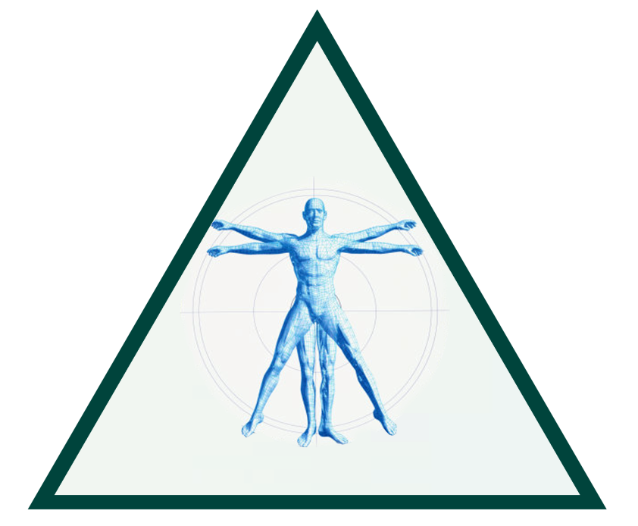
TRIAD OF CHRONIC PAIN TREATMENT
Physical/ Rehabilitative
Psychological
Medical
Pharmacological
Interventional
Notes:
The three aspects of the ideal treatment model are usually not available as publicly funded options in most communities in Canada.
Primary care physicians must be resourceful in accessing local resources for their patients so as to incorporate all three elements in their treatment plan.
However, all primary care physicians can offer medical treatment, and it is important to optimize pharmacotherapy.
Speaker notes/ Slide examples provided by January 2008 Ralivia Speakers’ KOL Bureau chaired by Dr. Roman Jovey MD (Physician Director, CVH, Addiction & Concurrent Disorders Centre; Past-President, CPS)

Slide 7
In life....
Good decisions come from wisdom
Wisdom comes from experience
Experience comes from bad decisions

Slide 8
General principles
Avoid opioid debt (of authorized opioids)
If in recovery program: Avoid opioids of past (or current) drugs of abuse
Be alert for alcohol or benzodiazapine withdrawal developing
Possible ‘golden moment’ in recovery

Slide 9
General principles
Take good notes especially around sedation, severity of pain and concerns of danger
Consider part of ‘team’ having an increased comfort with addiction/pain
An acute painful injury is not the time to ‘punish’ someone for having opioid dependence
COMMUNICATE, COMMUNICATE, COMMUNICATE

Slide 10
Case #1- Ron
What if a MMT patient requires acute perioperative pain Treatment?

Slide 11
Case - Ron
28 year old male on methadone 60mg for addiction who presents to the ER on Friday night due to injuries suffered in an MVA
Sustains a non-life threatening fracture of the ankle
Booked for surgery the following morning
He is complaining of inadequate pain relief and requesting more pain medication

Slide 12
Ron - Pre Op Considerations
Challenging patient as he may be at risk of relapse but…
…poorly treated pain is a bigger risk for relapse than giving adequate supervised analgesia
Often “opioid tolerant” but “pain intolerant”
Continuous opioid receptor occupation may produce hyperalgesia during less painful states and patients are unable to cope with sudden acute pain

Slide 13
Plan for Ron
Do your best to confirm Methadone dose and take home status.
Caution with high doses and multiple take home doses
If diverting, then in-hospital dosing could lead to toxicity
Overall impression is he’ll need more opioids and closer monitoring

Slide 14
Multimodal Perioperative Analgesia
given just before and for 2-5 days after surgery
Gabapentin 300-600 mg / day
OR
Pregabalin 50-75mg / day
Acetaminophen 1 gm QID
Celecoxib 400mg / day
Anesthetic blocks / infusions

Slide 15
Ron – Analgesia Plan
Planned surgery: ORIF # Ankle
Patient agrees to spinal block and supplemental ankle block
Day of surgery:
-give his Methadone 60 mg
avoid ‘opioid debt’

Slide 16
Ron - Post Op Considerations
Maintain Gabapentin, Tylenol and Celecoxib for at least 48 hours
Provide daily dose of methadone - communicate with methadone program to facilitate follow-up and discharge planning (and dosage adjustment if needed)
Pharmacy will need to arrange a temporary exemption to prescribe the methadone (613) 946-5139
Program PCA opioid doses at least 20-100% higher due to opioid tolerance (monitor carefully)

Slide 17
Ron - Post Op Considerations
Transition from IV PCA to oral opioids
Avoid converting patient to previous drug(s) of abuse
After discharge consider daily dispensing of oral opioids for a limited time along with Methadone
(how long should post-op pain last?)
Consider tramadol/ tapentadol instead?

Slide 18
Ron: Discharge Day
Speak with Pharmacy/ Doctor, confirm methadone dose given in hospital on day of discharge
Hydromorphone 8mg qid prn as daily dispense x 4 days with Methadone
Tip: attempt to avoid spontaneous Friday evening discharge

Slide 19
Case Ron – Key Learnings
Use multi-modal analgesic techniques
In a pt on MMT – confirm the dose and compliance
If unsure, give ¼ reported dose q 6h and observe
Continue methadone during admission (possible adjust dose if appropriate??)
Supplement with titrated PCA opioid (caution in iv injectors)
– expect higher dosage requirements

Slide 20
Message to methadone prescribers?
CPSO conference November 2013…

Slide 21
Acute pain - opioid
An acute pain condition is NOT the time to “punish” someone for opioid dependence
Avoid opioid of past misuse
Tie in dispensing to methadone dispensing
Communicate with other HCPs, know the usual natural history of pain condition
Possible tramadol, tapentadol

Slide 22
Case #2 - Mary
What to do when a patient on high dose opioids is coming in for elective surgery?

Slide 23
Significant opioid dose case
Pt presents for total knee replacement. Pt has been on opioids for chronic back pain and multiple joint pain due to OA. Pt taking OxyNEO 120 mg TID + percocet avg 2-4/ day.
Any special considerations?

Slide 24
Significant opioid dose case
Ensure they are taking the full dose
Possible urine screen if concerns
Will need higher dose requirements initially
Don’t create ‘opioid debt’
Assess what percentage of their opioid use is due to the operative area
Hopefully set goals to decrease opioid requirements eventually
Communicate with community opioid prescriber

Slide 25
Urine testing
Emerging standard of care
Point of care vs laboratory
What you expect IS there and what you don’t expect ISN’T there
Hopefully use as a TOOL in patient care
Document a plan when there is a discrepancy between:
Test and patients self report
Abnormal test

Slide 26
Considerations for high dose opioids
Sleep apnea?
Drug interactions. (Benzodiazapines)
Consider undertreated psychiatric diagnosis
Consider “rational polypharmacy”

Slide 27
Case #2 - Mary
Discharge plans
Hopefully able to balance her high opioid requirements with ability to appropriately rehab her recovery.
Communicate with original prescribing physician as to who will be prescribing the opioids and what new referrals and medications have been made

Slide 28
Case #3 - TJ
What to do when an untreated addiction patient comes in with significant painful injuries?

Slide 29
Addiction case
Pt presents to emergency room with a compound fractured ankle. Pt reports they are on hydromorphone CR 20mg BID or more and diazepam, cannot confirm dose as purchased illegally. Evidence of additional illicit drug use. History of mental illness. Pt will require surgery.

Slide 30
Addiction case “answers”
Difficult to verify opioid and benzodiazepine intake
Will probably need ‘a lot’ of pain meds (hydromorphone 40mg=morphine 200mg) just to avoid opioid debt
Small frequent dosing and close observation needed
Watch for benzodiazepine withdrawal
Avoid drugs of choice
“Golden moment”- suggest opioid substitution treatment, etc

Slide 31
Addiction case “answers”
Caution with iv/PCA pump and ‘friends’ visiting
Daily dispensing for short time on discharge as safety may be of greater importance than adequate pain relief
Attempt to avoid “more abusable” opioids

Slide 32
Pseudoaddiction
An iatrogenic misinterpretation caused by undertreatment of pain that is misidentified by the clinician as inappropriate drug-seeking behaviour
Behaviour ceases when adequate pain relief is provided
Not a diagnosis, rather a description of a clinical interaction
Weissman DE, Haddox JD. Pain. 1989;36:363-6.
Notes:
Many medical students are taught that if opioids are prescribed in high doses or for a prolonged time, the patient will invariably become an addict. Therefore, the common wisdom is to prescribe the lowest possible dose at the longest possible dosing interval. As a result, opioids are frequently prescribed in doses that are inadequate and at time intervals beyond the duration of action of the drug, resulting in poor analgesia.¹
The term pseudoaddiction was first introduced by Weissman and Haddox in 1989 to describe the iatrogenic syndrome of abnormal behaviour developing in direct consequence of inadequate pain management.² They described the natural history of pseudoaddiction as a progression through 3 characteristic phases including: (1) inadequate prescription of analgesics to meet the primary pain stimulus; (2) escalation of analgesic demands by the patient associated with behavioral changes to convince others of the pain's severity; and (3) a crisis of mistrust between the patient and the health care team. Treatment strategies include establishing trust between the patient and the health care team and providing appropriate and timely analgesics to control the patient's level of pain.^{2,3} 1. Schnoll SH, Finch J. Medical education for pain and addiction: making progress toward answering a need. J Law Med Ethics. 1994;22:252-6.
2. Weissman DE, Haddox JD. Opioid pseudoaddiction—an iatrogenic syndrome. Pain. 1989;36:363-6.
3. A consensus document from the American Academy of Pain Medicine, American Pain Society, American Society of Addiction Medicine. Definitions Related to the Use of Opioids for the Treatment of Pain. 2001.

Slide 33
Can we adequately treat ACUTE pain in a patient on long term Buprenorphine/Naloxone therapy?

Slide 34
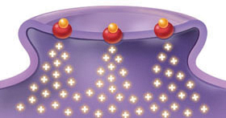
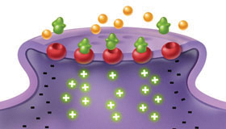
BUPRENORPHINE: A PARTIAL µ OPIOID RECEPTOR AGONIST
Partial µ opioid agonist
Kappa receptor antagonist
Less dopamine release
Heroin, methadone produce maximum dopamine release
Buprenorphine produces less dopamine release
High affinity for µ receptor
Can displace full agonist opioids, such as heroin
Dissociates slowly from the receptors
Low intrinsic activity
Ceiling on agonist effects
Heroin, methadone
(Full agonist)
Buprenorphine
(Partial agonist)
Red balls = µ opioid receptors
Yellow balls = heroin
Green shapes = buprenorphine
Johnson RE, et al. Drug Alcohol Depend; 2003.
Notes:
34
Buprenorphine is a partial agonist at the mu opioid receptor. It also has antagonist activity at the kappa receptor, so it’s sometimes referred to as a mixed agonist-antagonist.
Whereas activation of a receptor by a full agonist like heroin or methadone produces maximal release of dopamine, buprenorphine activates the same receptor to a lesser degree, causing lower dopamine release, as you can see in this diagram. The red balls are the receptors, and the green balls represent buprenorphine.
In addition, buprenorphine has a very high binding affinity for the mu receptor, which allows buprenorphine to displace most other opioids from the receptor, and dissociates slowly from the receptors once it is bound.
Buprenorphine has low intrinsic activity, with a ceiling on its agonist effects; this is discussed further in the next slide.
Johnson RE, Strain EC, Amass L. Buprenorphine: how to use it right. Drug Alcohol Depend. 2003;70(2 Suppl):S59-S77.

Slide 35
Management of Acute pain in a patient on Buprenorphine
Anticipated single dose (dental procedure)
Encourage non-opioid
If opioid given, avoid past drug of choice
Single dose may be effective if bup/nx is not discontinued

Slide 36
Management of Acute pain in a patient on Buprenorphine
Anticipated multi-dose (minor surgery)
Encourage non-opioids
Increase pre-op non-opioids (Celocoxib, Pregabalin)
Use local blocks if possible
Possible increase bup/nx dose (divided)

Slide 37
Management of Acute pain in a patient on Buprenorphine
Anticipated multi dose (Major surgery)
Attempt to hold bup/nx for 24-36 hours prior to surgery (creating opioid debt)
Initially larger doses of other opioids may be needed, this may decrease over 72 hours as buprenorphine is being eliminated
Avoid drug of choice, small amount dispensed, know usual time line of recovery

Slide 38
Management of Acute pain in a patient on Buprenorphine
Unanticipated pain (trauma surgery)
Discontinue bup/nx
Initially larger doses of other opioids may be needed, this may decrease over 72 hours as buprenorphine is being eliminated
Monitor carefully
Restart bup/nx when it is appropriate to do so

Slide 39
Take home messages
Communicate well within:
Your team
Your hospital
Community prescriber

Slide 40
Questions?

